Slide 1
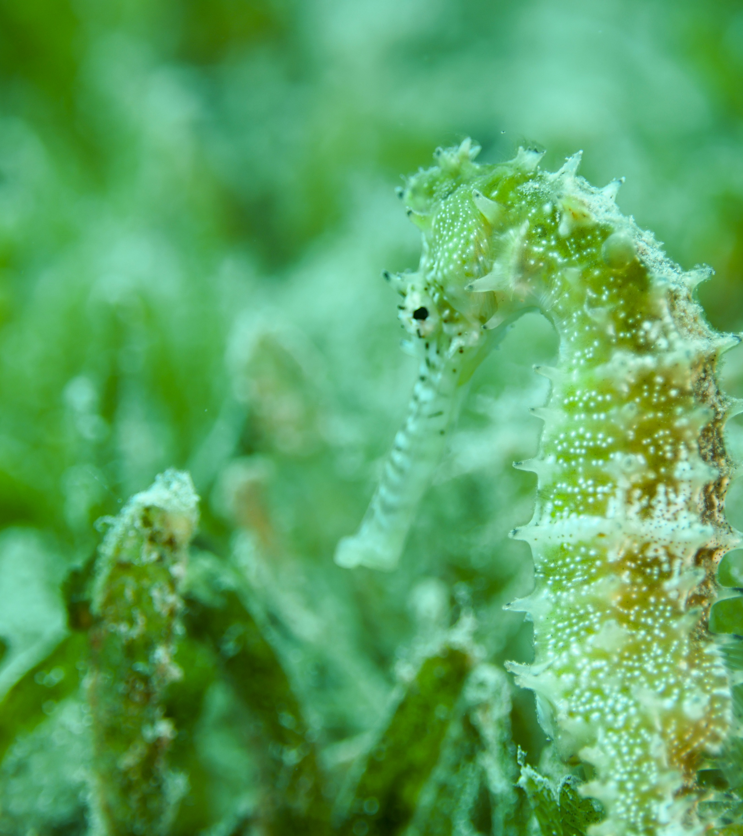
Aquatic Conservation: Marine and Freshwater Ecosystems

Slide 2
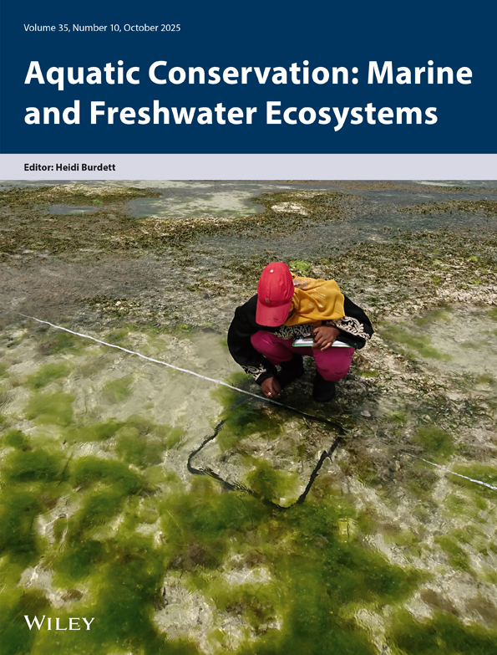


Aquatic Conservation:
Marine and Freshwater Ecosystems
Our Journal is an international journal dedicated to the multidisciplinary science of conservation in all aquatic ecosystems. We provide a nexus for discussion of aquatic conservation issues across systems and disciplines.
Why choose our journal?
We regularly publish special and virtual issues on current topics in the field.
Global platform fostering multidisciplinary discourse on aquatic conservation in diverse ecosystems.
We are an inclusive journal welcoming contributions spanning research, industry, policy, and more.
Addressing conservation issues from local to global scales, emphasizing practical and theoretical perspectives.
Visit the journal homepage

Slide 3
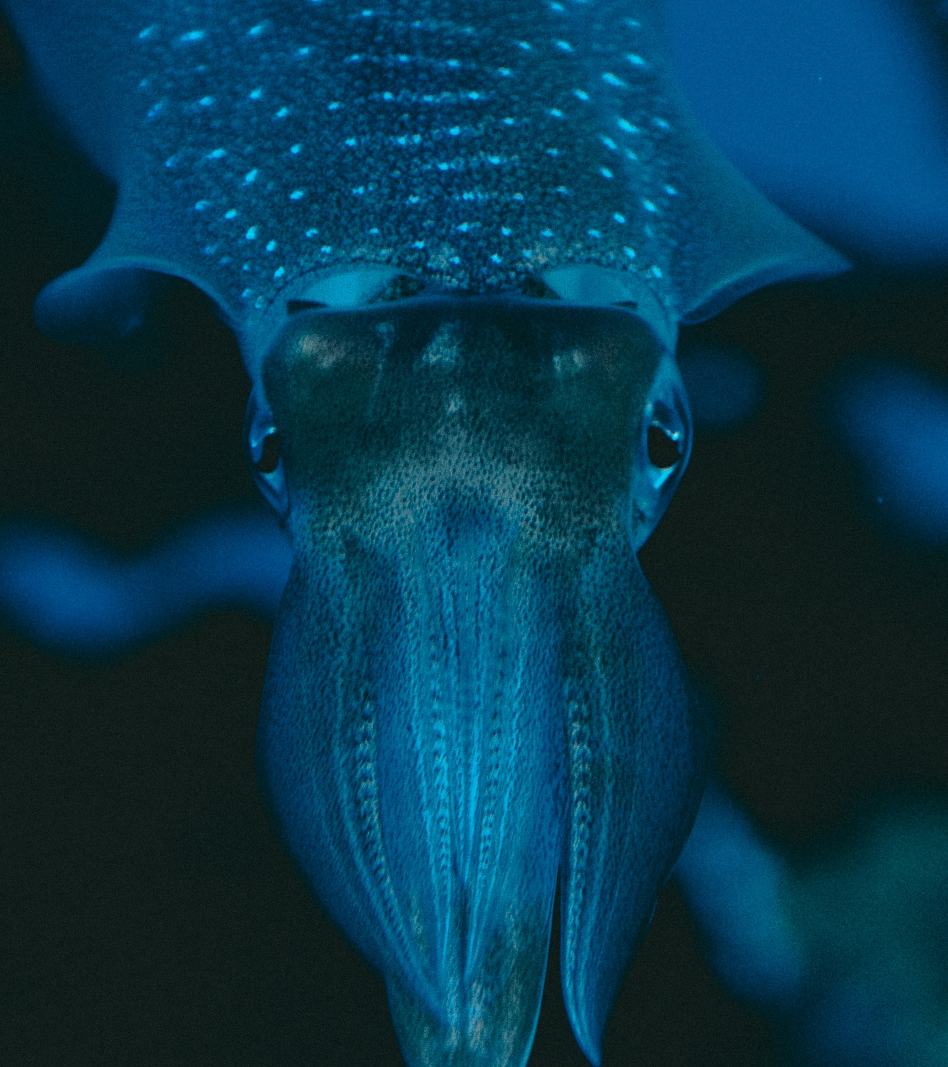

Call for Papers
Aquatic Conservation:
Marine and Freshwater Ecosystems
Advance the future of cephalopod conservation by contributing your multidisciplinary research on cephalopod life history, biodiversity, genetics, ecology, and fisheries.
We are seeking papers that fill critical knowledge gaps to support conservation action, particularly those adopting new and innovative techniques like artificial intelligence, remote data acquisition, or mixed-methods approaches."
Submit by 31st March 2026

